Slide 1


SUPER PV
CoSt redUction and enhanced PERformance of PV systems
Project Overview
The SUPER PV project has received funding from the European Union's Horizon 2020 Research and Innovation Programme under Grant Agreement
No. 792245

Slide 2
Facts
PV deployment growth is an unmatched success story in the energy sector over recent years.
However, European PV manufacturers are facing a decline in production due to competition from third countries.
The fragmentation of the value chain is believed to be one of the major factors for this decrease in the competitiveness.

Slide 3

The Project
European-funded project
Started in
05/2018
26 Partners
LCOE reduction (26%-37%)

Slide 4
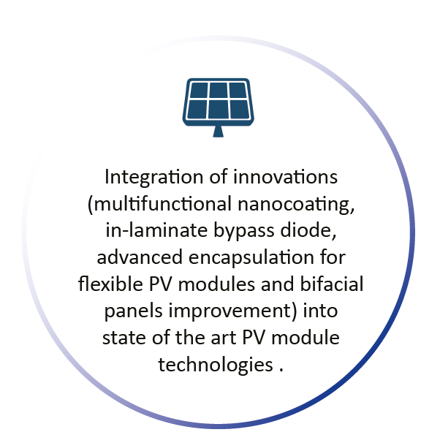
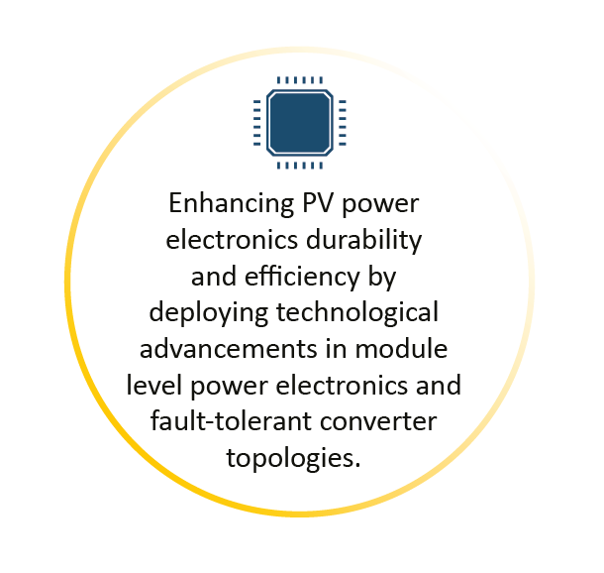
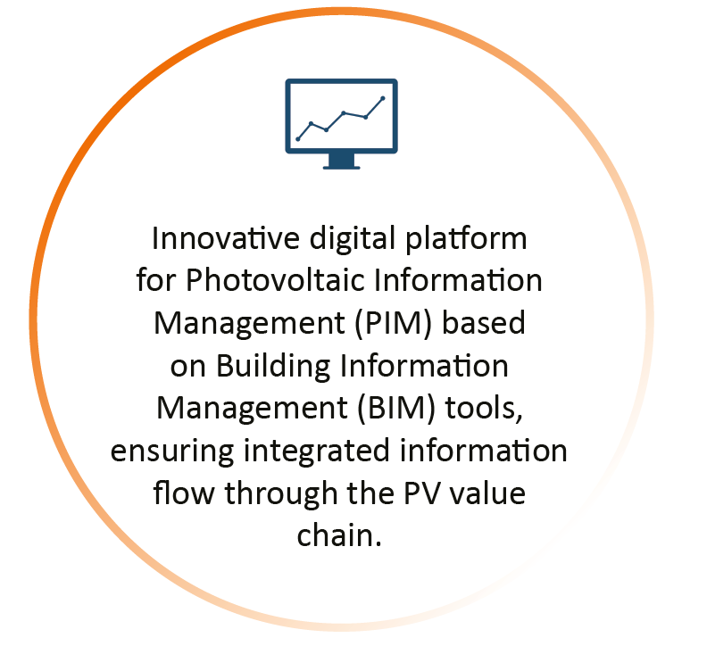
Innovations
Development of superior quality PV systems, based on a hybrid combination of technological innovations and business operation solutions, aiming to accelerate large scale deployment in Europe and help EU photovoltaic business to regain leadership on world market.

Slide 5
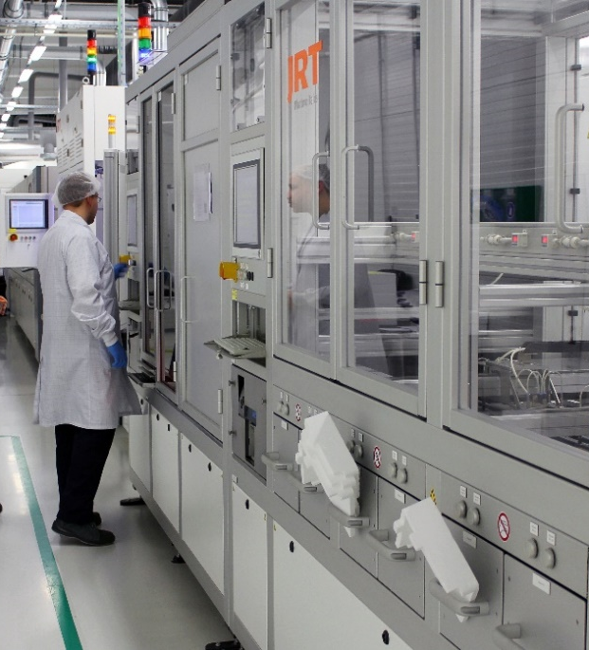



Methodology and Expected LCOE Reduction
Development of technology innovations and novel data management tools
Testing of he innovations and methods in real conditions
Evaluation of the effectiveness of the proposed solutions
7-14 %
LCOE (life time costs/energy production)
4-5 %
12-18 %
Additional Reduction

Slide 6
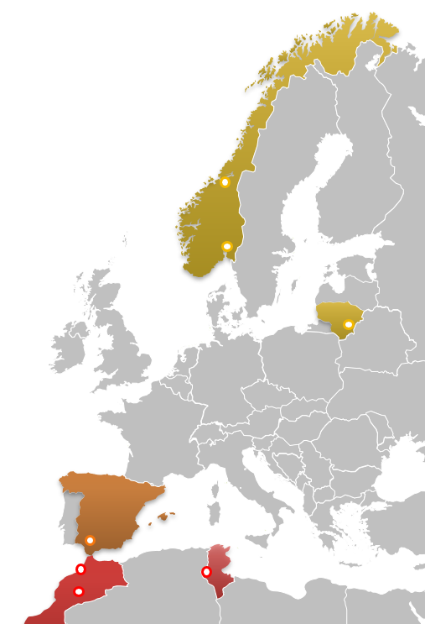




Demo-Sites
In harsh climate conditions to evaluate cost efficiency and demonstrate competitiveness of the solutions
Temperate (cold/wet) climate
-Norway: Oslo & Trondheim
-Lithuania: Vilnius
Tropical (hot/wet) climate
-Spain: Sevilla
Desert (hot/dry) climate
-Morocco: Ouarzazate & Rabat
-Tunisia: Tozeur

Slide 7
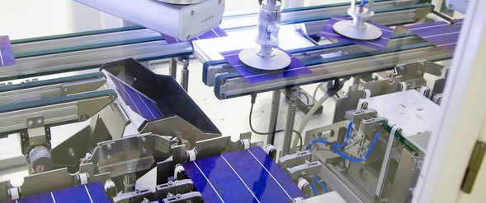
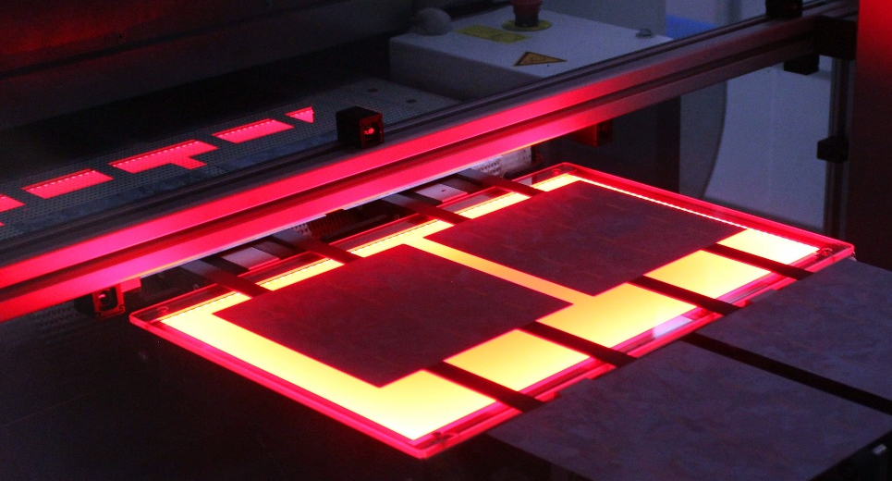
Dissemination of Results, Training and Business Cases Development
Dissemination of scientific and commercial innovations developed and their associated benefits, facilitating market uptake.
Practice oriented education, training and knowledge exchange carried out in the demonstration facilities.
Viability study of realistic use scenarios for proposed PV systems to support the business development.

Slide 8
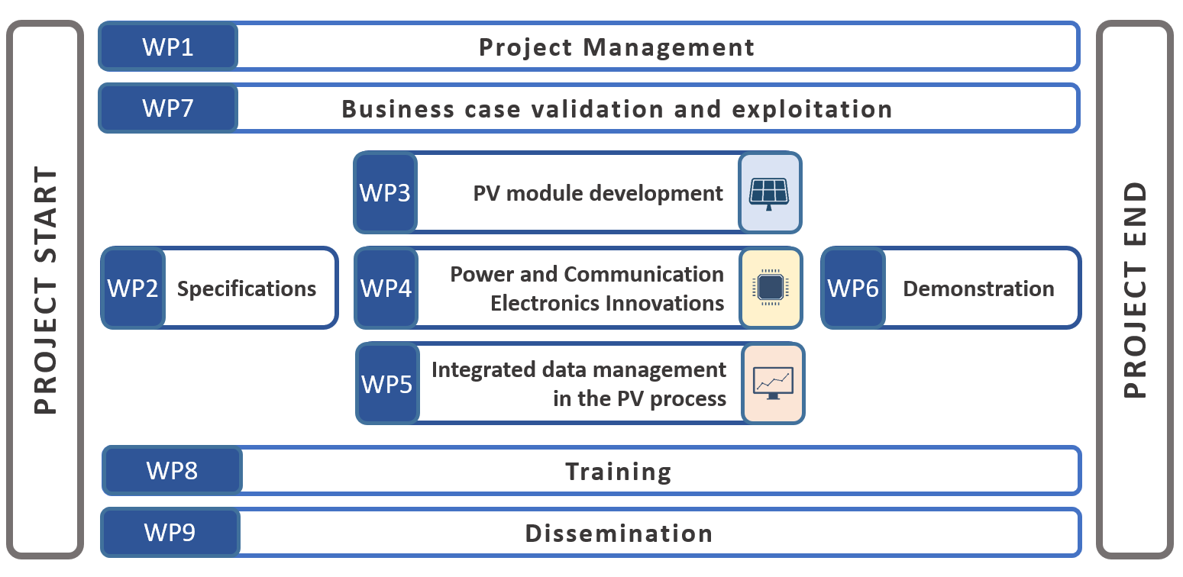
Organization Scheme

Slide 9
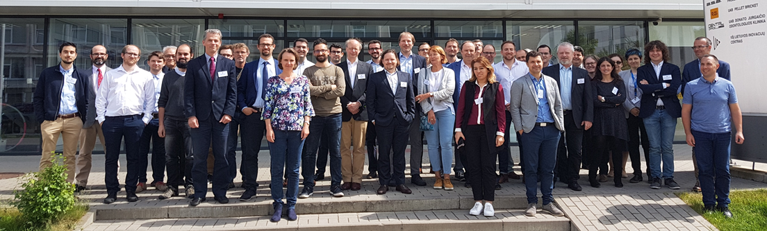
The Consortium
Teams addressing particular project objectives are combining research institutions and industries directly involved in the related business this way ensuring synergy of research knowledge on innovative technologies with experience from real business environment.
Specialized business support partners known on their high competencies in PV area are also taking part in the project. Such approach will ensure fastest possible uptake of introduced innovations.
Solitek and Protech as Project Coordinators

Slide 10
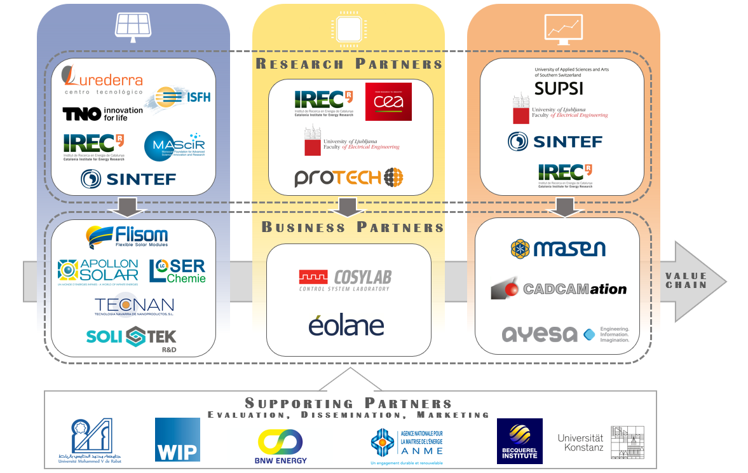
The Consortium

Slide 11
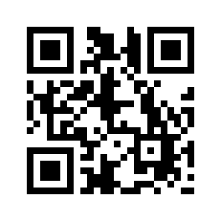


Learn more about our Project:
www.superpv.eu
@SUPERPV_H2020 / #SuperPV

